Slide 1
CPEN 422
Software Testing and
Analysis
Ali Mesbah
ECE, UBC
Notes:
Welcome
Elevator pitch:
Methods & techniques to ensure that you deliver high quality software systems
Picture: Composition by Malevic
Composing software
Different levels of abstraction.
Course in English: OK?
1st hour
Getting to know each other
Why this course matters
How it is structured
How to successfully
2nd hour
Fundamentals of software testing and quality engineering
Part I / chapters 1-4 / pp. 1-50 of book

Slide 2
Today’s Objectives
Getting to know each other
What is this course about?
How to successfully pass this course

Slide 3
Contact Info
Lecturer: Dr. Ali Mesbah
Email: amesbah@ece.ubc.ca
Office: KAISER 4044
Office hours: by appointment

Slide 4
Bio
Professor @ UBC (2021-now)
Visiting Scientist @ Google (2017-2018)
Associate Professor @ UBC (2016-2021)
Assistant Professor @ UBC (2011-2016)
Visiting Researcher @ Fujitsu Labs (2010)
PhD in CS @ TU Delft (2005-2009)
Software Engineer (2001-2005)

Slide 5
Software AnaLysis and Testing (SALT) http://salt.ece.ubc.ca
Research Group:
3 PhD, 3 MSc
Undergrad Interns
Teaching:
Software construction
Software verification
Software testing and analysis
Research:
Software engineering
AI4SE: Generative AI
Software testing and analysis
Web and mobile engineering
Partners:
Collaboration with ~10 different companies

Slide 6
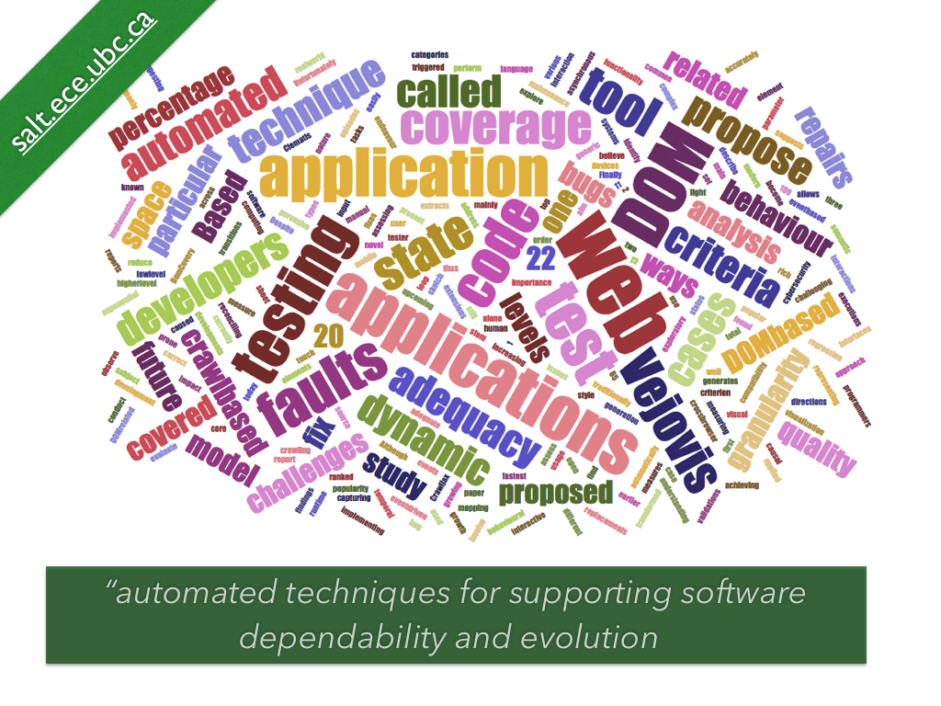

Slide 7
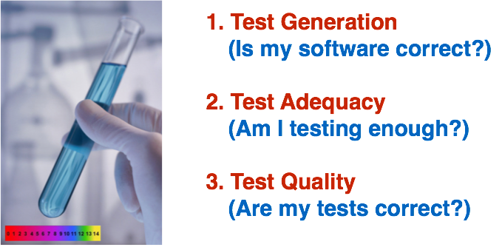
Our Testing Research

Slide 8















Slide 9
My research @ Google
Learning to fix compilation errors automatically
Machine learning, deep learning
Neural Machine Translation
Large-scale Refactoring for Java Type Migration
300 millions lines of Java code

Slide 10
Resources
UBC Canvas
Syllabus
Lecture notes
Piazza (join)
All questions and discussions
GitHub (Lab work)
https://github.com
Create an account on GitHub if you don’t have one!
Submit your account (see Canvas for announcements).

Slide 11
TA
Sijia Gu
Contact them via Piazza!

Slide 12
Assessment
Active Participation: 05%
Presentations: 10%
Midterm (October 56): 15%
Lab Work: 30%
Final Exam: 40%

Slide 13
Canvas and Piazza
Canvas
Syllabus (read it!)
Lecture notes after each lecture
General announcements
Piazza
Q&A, discussions -> participation marks!
Lab related announcements

Slide 14
Active Participation
Active participation means
class attendance,
participation in the discussions in the class and online
asking good questions, responding to questions asked

Slide 15
Student Presentations
Each student/group presents once
A topic on software testing and analysis (more details will follow)

Slide 16
Student Presentations
Topics:
A related technique
A tool, + demo
A paper/article
Industrial case studies
A list of potential topics will be provided soon.

Slide 17
Lab Work
Work in Groups of 2
Lab meetings with TA during lab sessions
Assignments
Project (open-ended)

Slide 18
Lecture Style
This will vary!
Sometimes the lectures will be very typical, where I talk on a certain topic
Mostly mini-lectures plus in-class exercises -- here’s where participation comes in!
Some will be async (watch a video/lecture)
Presentations by you on hot testing related topics and tools

Slide 19
Questions?

Slide 20
What is software verification and testing?
Why is it important?
What do you want to learn in this course?

Slide 21
Part II: Preliminaries
Pezze & Young
Chapters 1-4

Slide 22
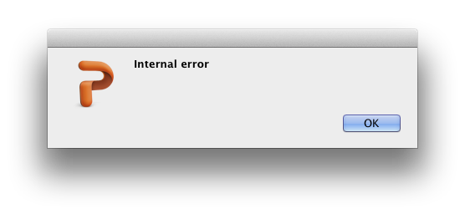
Notes:
What are today’s objectives?
First of all, demonstrate relevance of the topic.

Slide 23
Notes:
What are today’s objectives?
First of all, demonstrate relevance of the topic.

Slide 24

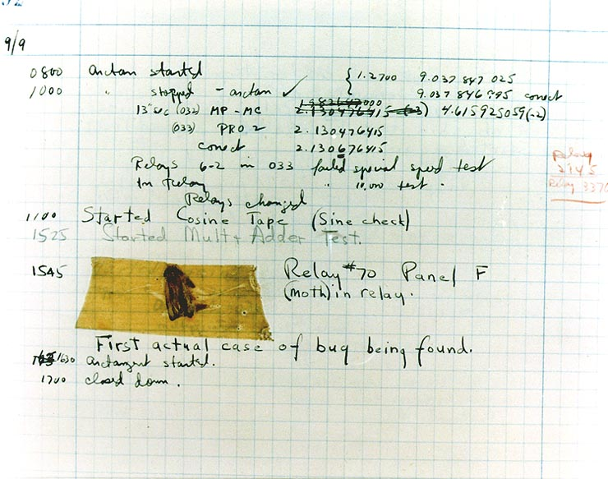
Bug
1946
Notes:
In 1946, at Harvard, operators traced an error in the Mark II to a moth trapped in a relay, coining the term bug. This bug was carefully removed and taped to the log book. Stemming from the first bug, today we call errors or glitch's [sic] in a program a bug. REEELAY

Slide 25


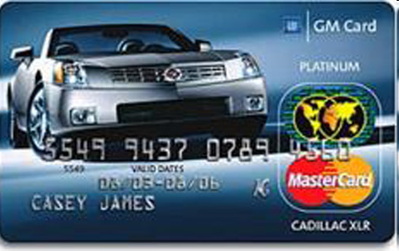


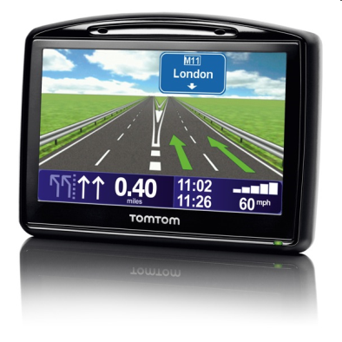
“Our civilization runs on software”
Notes:
Whittaker: “The Magic of software”
We love making software
We change society

Slide 26
“Software is eating the world”
Discuss with your neighbors and write down
What does this sentence mean?
Do you agree?
Can you provide some examples?
Notes:
Marc Andreessen: Netscape

Slide 27
“Software is eating the world”
Marc Andreessen (Netscape)
Digital docs (PDF) ate libraries
E-mail ate mail services
Netflix ate video stores
Expedia ate travel agents
Amazon is eating retail stores
Uber is eating taxis
AirBnB is eating hotels
…
Notes:
Whittaker: “The Magic of software”
We love making software
We change society

Slide 28
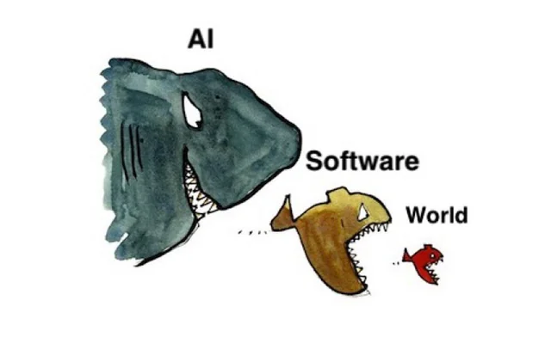
“AI is eating the world”
Discuss with your neighbors and write down
What does this sentence mean?
Do you agree?
Can you provide some examples?
Notes:
Marc Andreessen: Netscape

Slide 29
Software Dependability
More and more we depend on software
Which in turn means software needs to be more and more dependable!

Slide 30
Boeing 787 (Dreamliner) bug
A software bug that causes a complete electric shutdown of Boeing’s 787 and potentially “loss of control” of the aircraft.
http://www.theguardian.com/business/2015/may/01/us-aviation-authority-boeing-787-dreamliner-bug-could-cause-loss-of-control
Notes:
“If the four main generator control units (associated with the engine-mounted generators) were powered up at the same time, after 248 days of continuous power, all four GCUs will go into failsafe mode at the same time, resulting in a loss of all AC electrical power regardless of flight phase.”

Slide 31
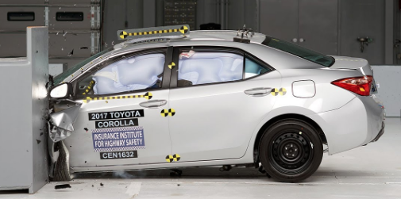
More examples of software defects
Toyota's electronic throttle control system (ETCS) had software bugs that could cause unintended acceleration. At least 89 people were killed as a result
In 2013, US court rules against Toyota:
Toyota’s ETCS source code is of unreasonable quality.
Toyota’s source code is defective and contains bugs, including bugs that can cause unintended acceleration.
code-quality metrics predict presence of additional bugs.

Slide 32
More infamous examples
NASA Mars Polar Lander destroyed
its flight software mistook vibrations due to atmospheric turbulence for evidence that the vehicle had landed and shut off the engines 40 meters from the Martian surface!
Apple’s “goto fail” bug: a duplicated line of code which caused a (SSL) public key certificate check to pass a test incorrectly.
Heartbleed, an OpenSSL vulnerability
900 SINs stolen from Canada Revenue 2014

Slide 33
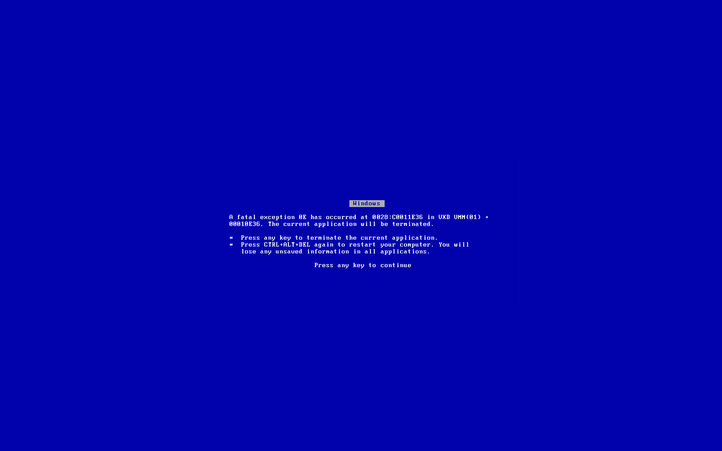
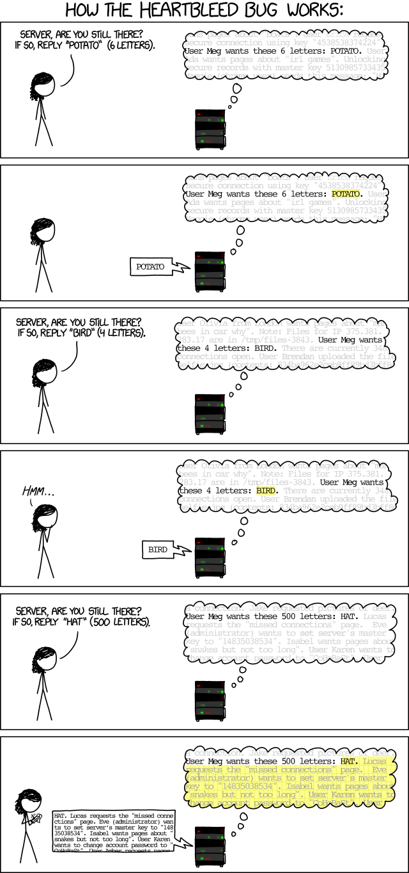

Slide 34
Recent Microsoft Meltdown
More than 8 million Microsoft users reported on 19 July 2024 that their computers wouldn’t turn on, with monitors showing the “blue screen of death”
Television stations went offline, air travel was disrupted and hospitals were forced to cancel appointments.
Root cause?

Slide 35
Recent Microsoft Meltdown
Root cause
a faulty update distributed by the cybersecurity company CrowdStrike
Update was in their Falcon sensor software, which operates deeply within the Windows OS
Out-of-bounds error:
the software incorrectly expected 20 input fields but it encountered 21 fields instead.

Slide 36
“It's all done. I just need to test it.”

Slide 37
“It's all done. I just need to test it.”
“It's much easier to develop software when it doesn't have to be correct. :)”

Slide 38
CPEN 422
What do you want to learn in this course?

Slide 39




This Course
Techniques
The basics to be effective
Embedding in development process
Testing as a communication vehicle
Early testing as a design activity
Testing shapes the system
Testing as an engineering discipline
Tradeoff in costs and quality
Scientific basis

Slide 40
Skills You’ll Learn
Test design:
Which test cases are likely to reveal errors?
Test assessment:
Have I tested enough? Are my tests good?
Analysis techniques
Control-flow analysis
Data-flow analysis
Static bug checkers
Notes:
Binder, Ch.3.
A better tester, and a better system builder.

Slide 41
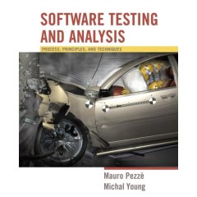
Textbook
You can request a free digital copy of the book:
^{https://ix.cs.uoregon.edu/}~^{michal/book/free.php}

Slide 42
Pezzè & Young
Part I: Intro
Part II: Basic techniques
“finite abstractions of behavior”
Part III: Problems & Methods
Test case selection, test adequacy
Functional & model-based testing
Testing object-oriented software
Part IV: Process
Notes:
Practical applicability
Strong theoretical foundation.

Slide 43
The Book: Pezzè & Young
xvii
Goal is to
achieve balance of costs, schedule, and quality
Testing and analysis are
integral to modern software engineering practice
equally important and technically demanding as other aspects of development
Notes:
Practical applicability
Strong theoretical foundation.

Slide 44
Learning Objectives
Knowledge level
Raw facts: essential software analysis methods, tools, techniques, ...
Application level:
Practical: actually use selected techniques
Evaluation level:
Analytical: Decide what’s useful in your project
Criticize, analyze, investigate, reflect, innovate, ...
Be a better Software Analyzer -> Developer -> Manager -> Engineer
Notes:
Knowledge level: raw facts, raw material.
Application level: practicum.
Lectures: knowledge + evaluation!
Evaluation:
Be a better:
Tester
Developer
Software architect
Project manager
...
Software engineer

Slide 45
Topics Covered
Principles and Challenges of Software Testing: Understand the core principles, method- ologies, and common obstacles encountered in the testing process.
Static and Dynamic Analysis: Learn how to apply both static and dynamic analysis tech- niques to identify potential issues in software code and execution.
Requirements-Based Testing and Acceptance Testing: Explore the methods for ensuring that software meets specified requirements and is ready for release through thorough acceptance testing.
Levels of Testing: Gain proficiency in various testing levels, including unit, integration, and system testing, and understand their roles in the software development lifecycle.
Regression Testing: Study strategies for test selection, prioritization, and minimization to efficiently manage regression testing in evolving software systems.
Test Oracles, Invariants, and Assertions: Learn how to define and use test oracles, invari- ants, and assertions to validate software behavior and ensure correctness.

Slide 46
Topics Covered
Test Adequacy Criteria and Code Coverage: Develop an understanding of test adequacy criteria and how to achieve comprehensive code coverage.
Fault-Based Analysis and Mutation Testing: Explore fault-based techniques, including mutation testing, to assess the effectiveness of test suites.
Program Analysis: Delve into advanced program analysis techniques, such as symbolic exe- cution, concolic testing, control-flow analysis, and data-flow analysis.
Problem Tracking, Debugging, and Fault Localization: Acquire skills in identifying, tracking, and resolving software issues through debugging and fault localization.
Program Repair: Learn techniques for automatically repairing software defects and improving code reliability.
Domain-Specific Software Testing: Study the unique challenges of testing domain-specific software systems, including web applications, mobile apps, and graphical user interfaces (GUIs).
Test Generation and AI-Assisted Testing: Explore modern approaches to test generation, including the use of AI-assisted techniques to enhance test creation and execution.
Automation and Tool Building: Gain hands-on experience in building automated testing tools and frameworks to streamline and improve the efficiency of the testing process.

Slide 47
Questions?

Slide 48
Testing a SaaS
You are hired as a test engineer.
The goal is to improve the quality and find any current and potential future bugs.
In pairs, devise a test plan in which you outline how you would go about achieving the goal.

